Slide 1
Bank Accounting

Slide 2
Table of Contents
Bank Master Data
Check Processing
Bank statement
Cash Journal Master Data
Cash Journal Posting & Reports

Slide 3

Bank Master Data - Objectives
Upon completion of this module, you will be able to:
  Define, change and delete bank data,
  Define the house banks for company code,
  Maintain bank accounts.

Slide 4

Bank Master Data - Bank Accounts
Bank Account in the SAP system
Bank GL accounts - master data
House bank
Account number
Account ID
Account ID
Bank Account number at the house bank
Notes:
There are two main factors to be considered while managing bank accounts in SAP system:
House banks
Bank accounts
For every company code we need to define its house bank. These are an equivalent of the “real” banks that the company operates with.
For every house bank there are defined one (or more) bank accounts - these are simply our bank accounts per house bank.
The bank account data contains the number of the account at the bank, the account currency and the G/L account which reflects the postings on your bank account in the general ledger.
For each bank account, a G/L account must be created. This G/L account is assigned to the bank account and vice versa. Both accounts have to have the same account currency.

Slide 5

Bank Master Data - Bank Directory
Bank Master records in the bank directory
Bank details in customer / vendor master records
Client Level
Client Level
Country Bank Key
Country Bank Key
Address data
Address data
Swift code…
GL Account
Notes:
Bank Master Records are created on the client level.
The bank data can be entered using the transaction FI01 or you can create / change bank details during editing Customer / Vendor Master Data (e.g. XK01).
Every time you create a new bank master, SAP system performs check of country specific items, e.g. how many digits are allowed in bank key.
Bank master records can be downloaded to your system from a database file, which can be obtained e.g. from your financial institution..
Also SWIFT provides a BIC file that can be uploaded using standard program RFBVALL_0.

Slide 6
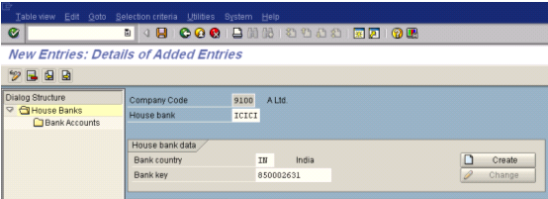
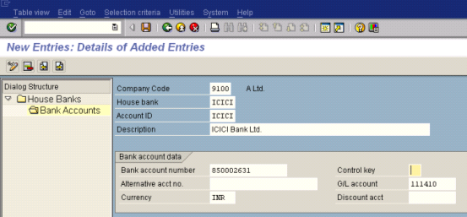
Bank Master Data - an Example
House banks for company code 1000
Bank account for House Bank

Slide 7
Table of Contents
Bank Master Data
Check Processing
Bank Statement
Cash Journal Master Data
Cash Journal Posting & Reports

Slide 8
Manual Check Deposit - Objectives
Upon completion of this module, you will be able to:
  Explain the procedure for depositing checks,
  Post the checks and clear the Customer Accounts,
  Run post processing transactions,
  Print Check Register,
  Change Check Information (renumber, change assignment etc.),
  Void checks.

Slide 9
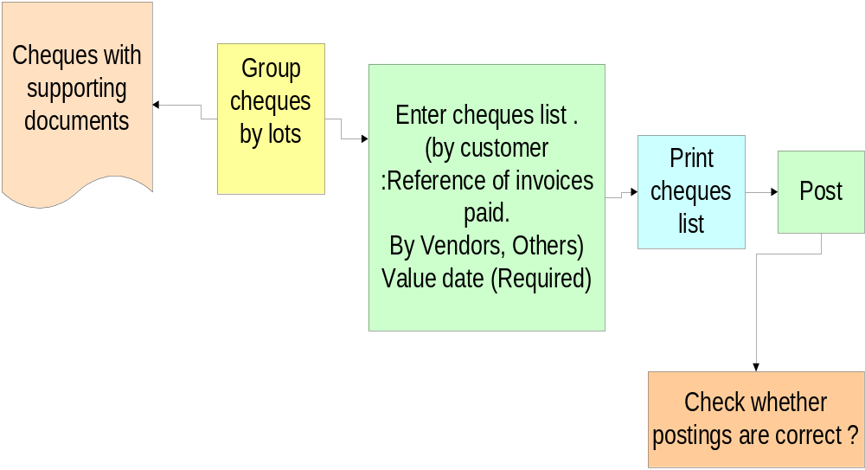
Manual Check Deposit - Activity Flow

Slide 10

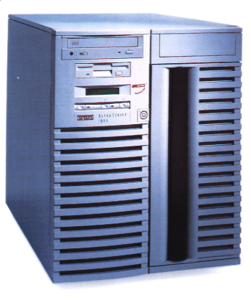
Manual Check Deposit - Procedure
Check deposit
list
Electronic / Manual
Entry
General Ledger
Documents
Temporary
Database
Sub-Ledger
Documents
Check
Notes:
One of the ways to post incoming checks is to use a functionality “manual check deposit”. A user enters only the checks received, not the posting records.
The system then automatically makes the postings to the bank clearing account and customer account, along with the payment clearing. You have two options here:
Immediate posting
Create a batch input session, then run it.

Slide 11

Check Deposit - Account Assignment
Check Deposit List
Postings
Customer Account
O.b.) 200,-
200,- (1
Incoming checks Account
1) 200,-
200,- (2
Bank Account
2) 200,-
Notes:
To process checks manually:
1. Enter checks. Remember to include clearing information: in A Ltd as a clearing information was chosen Customer short name and an invoice number (from SD Module). Create a batch input session or choose direct processing.
2. Run the sub-ledger session. Postings to bank clearing accounts (incoming checks) and to sub-ledger accounting (customer clearing).
3. Print the check deposit list and give it to the bank, along with the checks.
4. Process the bank postings.

Slide 12
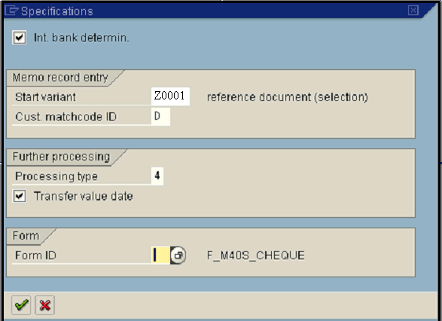
Check Deposit - Initial Specification
House Bank ID
Customer Matchode
Post processing method:
2 - batch input
4 - direct posting (on-line)
Notes:
This is the start variant and determines which fields are displayed when you are actually entering checks. You can change the account assignment variant at any time during processing.
If you select internal bank determination, the system identifies the bank using the internal name instead of the bank number and external account number. You can use either, according to what is usual in your company.
The match code ID D and the contents of the customer match code field on the next screen make up the match code of the customer account the system searches for (account determination for payment settlement).
The further processing type determines whether the postings in the batch input session are made online or in the background.
Transfer value date: The value date from the check entry is copied into the postings.
Specify a form ID if you want to use a form that differs from the standard form for the check deposit list.
For A Group we use start variant Z0001

Slide 13
Account Assignment Z0001
Amount
Issuer
Check no.
Ref. doc. No.
10000 INR ADITYA LTD 123445 123387
Customer Short Name
Invoice Number from SD
The account assignment variants determines which fields are being displayed during document entry. The system may display up to 3 lines available for each memo record or a check received.
For A Group we have been defined assignment variants Z0001.
Notes:
The data you’ve entered, like issuer short name and reference document number, are used later for clearing customer open items.
The system searches for open items using this data and tries to clear them. If the information entered is not sufficient to clear open items manually (e.g. wrongly entered document number) you need to process such open items manually.
The invoice number from SD goes to the field Reference in an FI document header and it is used later as a reference data for customer open items clearing.

Slide 14
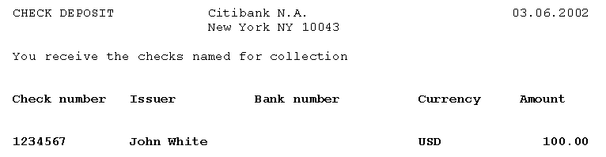
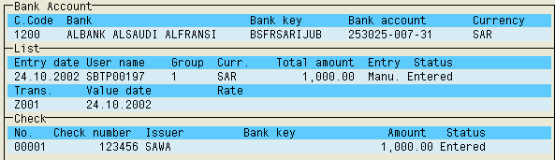
Check Deposit - Printing and Overview
Print
Preview
Print
Overview
Notes:
You can print the check deposit list directly from the entry screen. You can also print a totals list covering a number of check deposits.
The Print option allows you to display the form for printing. You can use the overview to gain a perspective over all your check deposits. It contains the following data:
Date entered
Entered by
Group name
Company code and currency
Total amount
Processing status
You can see how far check deposit posting has progressed by means of the processing status. If both postings and clearing postings have been made, the status will be "Posting completed". The incomplete posting status will appear if only the bank account postings have been made. If no posting has taken place, the status will be “Entered".

Slide 15
Check Deposit - Posting
Posting
Processing type 2
Batch Input
Direct Posting
Processing type 4
Process
Process
Log
Log
Notes:
The postings can be done immediately or processed in the batch input sessions.
The Post option generates postings immediately or the batch input sessions, including postings for sub-ledger accounts.
You can process the sessions individually or together, online or in the background (batch).
The log displays the processing statistics and any incorrect transactions.
Incorrect transactions, which were not processed due to inadequate clearing information, must be post processed:
If you are using batch input sessions, you must run these again online.
If you are using immediate postings, you need to use a transaction FEBA to clear the open items.

Slide 16
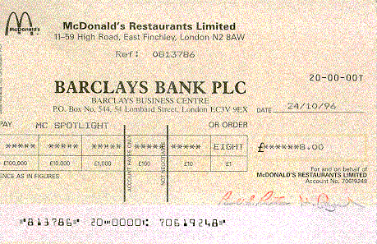
Check Information - Display
House Bank
Account ID
Check Number
Check Recipient
Check
Accompanying documents
Payment document
You can use these transactions to display the check data:
  For check,
  For payment document,
  Check register.

Slide 17
Check Information - Change
Check Processing
Renumbering
Check
Assignment to Payment
Reprinting
Sometimes it is necessary to change the information regarding already maintained checks.
SAP offers the following options:
  Renumbering of checks
  Reprinting
  Changing of the assignment to the payment.

Slide 18

Check Information - Void
Unused checks
Cancel Payment
Issued checks
The checks can be voided both before and after they have been printed.
You need to void the checks that are no longer usable for some reasons (e.g. check was stolen or incidentally damaged).

Slide 19

Check Information - Delete
For Payment Run
Delete or
Not to Delete?
Manual Checks
Voided Checks
Sometimes there’s the inconsistence between the data entered into system and the check forms,
You need to delete check information.

Slide 20
Table of Contents
Bank Master Data
Check Processing
Bank Statement
Cash Journal Master Data
Cash Journal Posting & Reports

Slide 21
Electronic Bank Statement - Objectives
Upon completion of this module, you will be able to:
  Understand the concept of posting rules and transactions used to post automatically electronic bank statement,
  Import bank statement data,
  Clear the outstanding items,
  Post process bank statement.

Slide 22
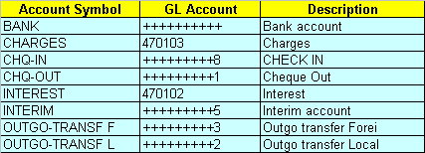
GL Account Determination
In Treasury account symbols are used instead of GL Accounts. The account symbol determines the G/L account to which postings are made.
You can also define accounts using “+” sign (masking). In such case the system uses GL account defined for a house bank.

Slide 23
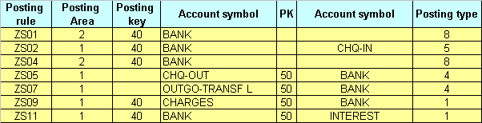
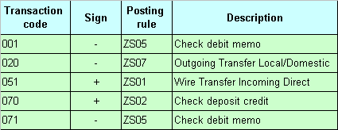
Posting Rules & Transactions
Posting rules
Business transactions
Notes:
The posting rules represent posting transactions typical of the bank statement, such as:
Incoming check
Credit memo
Debit memo
Posting specifications consist of one or two posting records debit -> credit, where the first posting record is called posting area 1, and usually represents a G/L account posting (BANK -> CASH RECEIPT, for example). The optional second posting record is called posting area 2 (CASH RECEIPT -> CUSTOMER, for example). Depending on whether a posting transaction affects bank accounting only, or also affects sub-ledger accounting, define the posting rules either for the first posting area only, or for both the first and the second posting areas.
Posting rules are assigned in the system to the transactions. The transaction characterizes a posting. The transactions will then be posted according to the same posting rules.
The system uses the posting area to determine whether it should post the items to the general ledger (1) or sub-ledger (2).

Slide 24
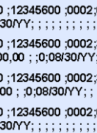


Bank Statement Processing - Overview
Files: 1) STATE.TXT
2) ITEM.TXT
Bank Postings
Bank Stat.
Process Electronic Bank Data (Statement)
Subledgers (D&K)
Notes:
Processing of electronic bank statement consists of two phases:
You need to import the bank data into the system (sometimes it is necessary to transfer the file into a format readable by SAP before),
Run the post processing transactions - clear and post the items that have not been posted automatically.
The transfer program (for example: MultiCash) uses the bank data to generate two files for further processing, STATE.TXT and ITEM.TXT. STATE.TXT contains bank statement header information and ITEM.TXT contains the transaction information. Using this format, a number of bank statements can be imported simultaneously.
For the import, you need to enter the format, along with the two file names, and stipulate the type of further processing. The system then automatically makes the postings to the bank account, bank clearing account, customer account, and, if required, vendor account, along with the payment clearing. You have two options here:
Immediate posting
create a batch input session, then run it.
We propose to use MT940 format file for Electronic Bank Payments.

Slide 25
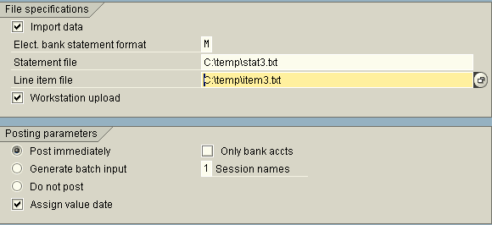
Bank Statement - Import Data
Files for further processing
Post-processing options
GL Bank Accounts
GL Clearing Accounts
Customers / Vendors Acc.
XXXX.XX
XXXX.XX
XXXX.XX
XXXX.XX

Slide 26
Table of Contents
Bank Master Data
Check Processing
Bank Statement
Cash Journal Master Data
Cash Journal Posting & Reports

Slide 27
Cash Journal - Master Data - Objectives
Upon completion of this module, you will be able to:
  Describe Cash Journals for your company code,
  Explain types of documents used for postings cash journal documents,
  Describe how to create Business Transactions for Cash Journal.

Slide 28
Cash Journal - Master Data (2)
Cash Journal
001 - Gen. Serv.
    A cash journal for a company code includes the following data:
      the 3 digit cash journal identification and name,
      the G/L accounts to which you want to post the cash journal accounting transaction
      the currency in which you want to run the cash journal
      the document types for posting cash outflows and inflows
Cash Account
110000

Slide 29
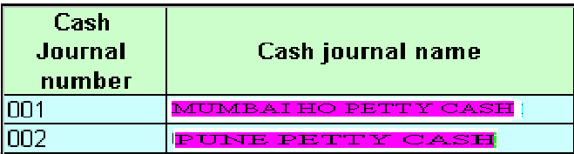
Cash Journal - Master Data
Company
Code 9100
A Ltd.
Notes:
The cash journal supports posting of cash receipts and payments. You can:
Have a separate cash journal for each currency
Post to customer, vendor and general ledger accounts
Use business transactions (instead of usually required postings keys & accounts) to post the data,
Define your own business transactions.
Transaction code to access cash journal is FBCJ.

Slide 30
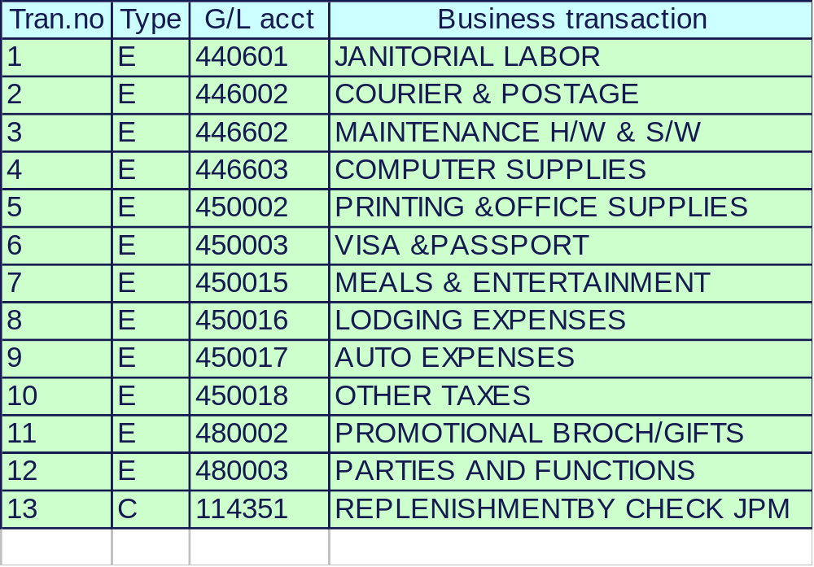
Cash Journal - Transactions
Notes:
A user can define a new cash journal accounting transactions in the cash journal itself (during document entry) - just type in in the field “Business Transaction” a name of your new transaction,
To create the business transaction, enter the following data:
the accounting transaction type, (Note: you cannot make an entry in the field G/L account for accounting transaction types D and K)
select a tax code for E (Expense) and R (Revenue), transactions which determines the accounting transaction control.
Once saved, the accounting transaction will be assigned a number automatically. During document entry, the accounting transaction can be called up by it’s name or it’s number.

Slide 31
Table of Contents
Bank Master Data
Check Processing
Bank Statement
Cash Journal Master Data
Cash Journal Posting & Reports

Slide 32
Postings & Reports - Objectives
Upon completion of this module, you will be able to:
  Save & Post Cash Journal documents,
  Delete & Reverse Documents,
  Print Cash Report for a certain period of time

Slide 33
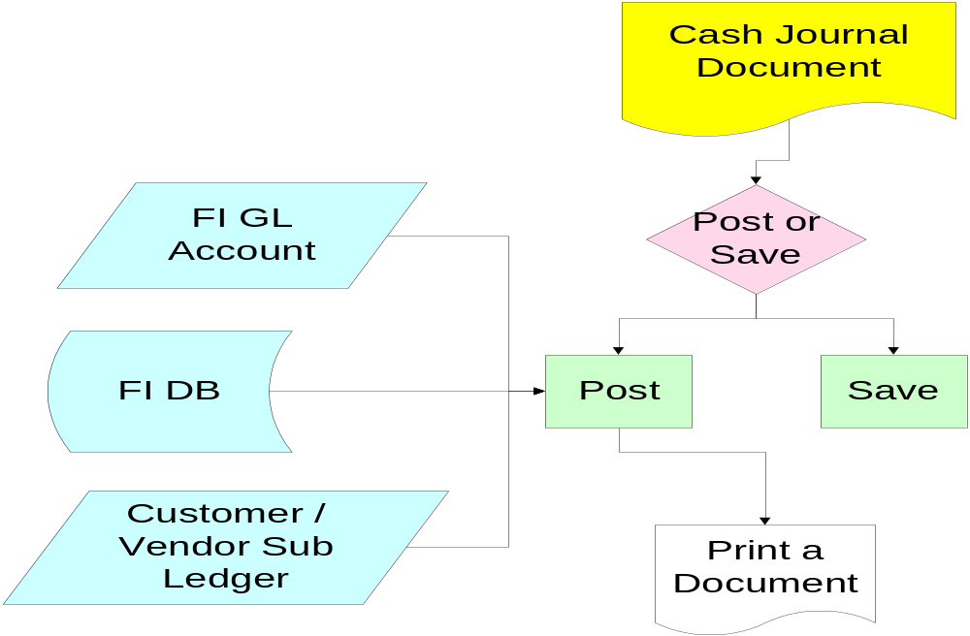
Postings & Reports - Activity Flow

Slide 34
Cash Journal - Postings & Reports
To post a cash journal transaction:
  Switch to the relevant transaction type:
    Cash receipts,
    Cash payments,
  Choose a business transaction code or create a new one,
  Enter all required data (amount, Cost Centre, Vendor / Customer account etc.)
  Save or Post your transaction,
  Print cash journal document
Notes:
Cash Journal entries are saved locally in the cash journal sub-ledger, but postings are automatically calculated and displayed on GL, Vendor and Customer accounts.

